Slide 1
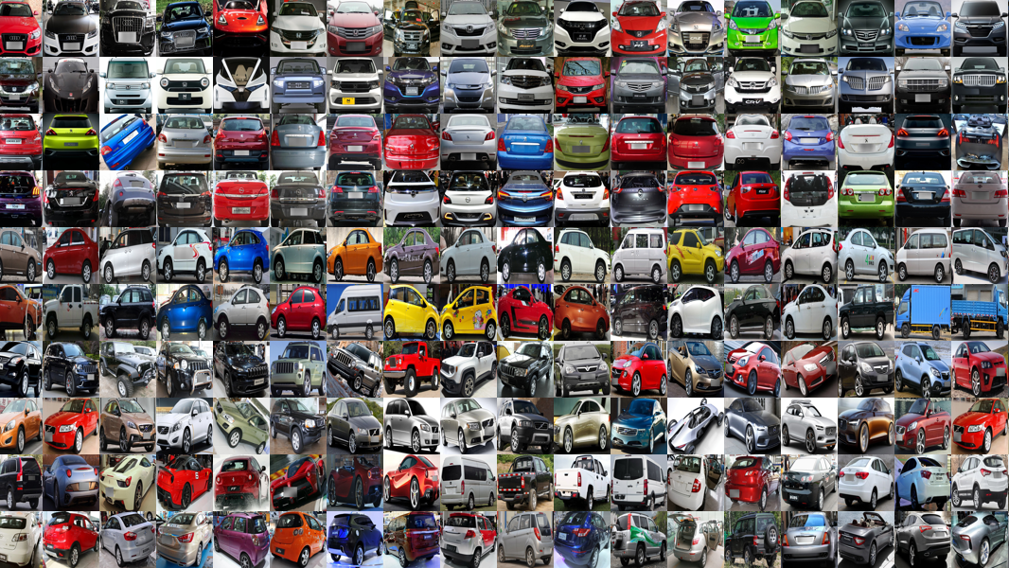
Bosch Assessment Data Scientist
Ana Nunes

Slide 2
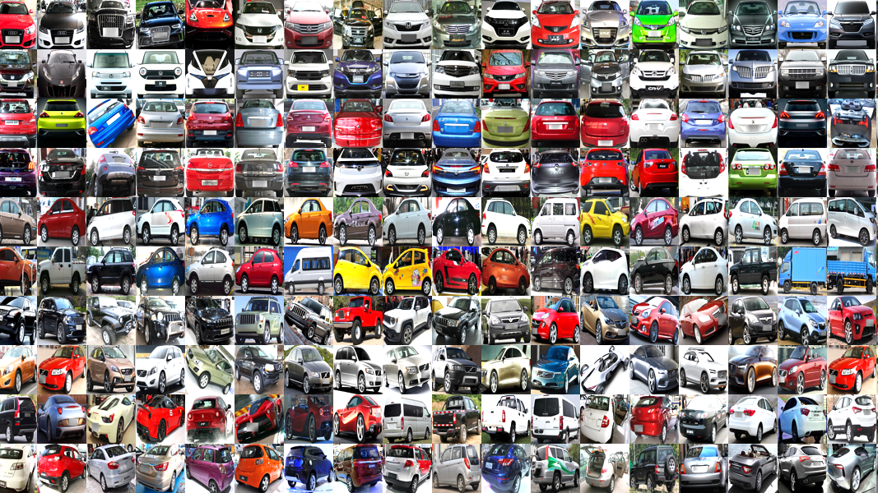
Overview
The objective was to perform a thorough analysis of the automobile dataset and build a machine learning model to predict a target variable (price).

Slide 3
Summary
Exploratory Data Analysis (EDA)
Missing Values
Data Distribution
Categorical Variables Encoding
Outlier Removal
Correlations
Feature Engineering and Selection
Machine Learning Model
Evaluation and Interpretation
Conclusions

Slide 4
Exploratory Data Analysis (EDA)

Slide 5
Missing Values

Slide 6
Data Distribution

Slide 7
Categorical Variables Encoding

Slide 8
Outlier Removal

Slide 9
Correlations

Slide 10
Feature Engineering and Selection

Slide 11
Machine Learning Model

Slide 12
Evaluation and Interpretation

Slide 13
Conclusions

